Slide 1
TOWN
APRIL 13, 2024
HALL
SOUTHSHORE LIGHTHOUSE
Notes:
Timeline 10 to 12. STAR Team at 9 for setup
Intro - Kevin - history of STAR
Basic Preso - Bill
Mike Foote
Shane Videos - Randy
Q&A
Announcements
I missed these
they went fast….Please Correct Them
fund the fight
spring fling
CHAT CAP - Randy announce
Action Item Checklist - Marsha
Gear
Commentary
Onsite questions
Booth Time
Childcare 10-11

Slide 2
Just the Facts
Information on the potential impact of fracking
near the Aurora Reservoir and our community

Slide 3
It’s not over!
The major takeaway from this presentation is that this process is not a done deal!
We still have a chance to stop this
STAR has done amazing work and can benefit even more from your commitment of time and $$

Slide 4
General Facts Regarding Fracking
What is hydraulic fracturing, or fracking?
Hydraulic fracturing (fracking) is not like a conventional oil well that you drill down and pump from a pool of oil.
Fracking drills downward, and then turns to drill horizontally for up to 6 miles.
After drilling it involves explosions to create initial fractures, and then very high-pressure injections to create larger and longer fractures.
The “produced water” is permanently contaminated.
Water that comes back to the surface can carry toxic fluids, which, if mishandled could negatively impact drinking water, residential basements, and other susceptible infrastructure.
IMPORTANT FACT
Operators can’t completely control where fractures occur. When a fracture extends farther than intended, it can link up with a naturally occurring fault, other natural or man-made fractures, or other wells and then carry fluids to other geological formations, including, potentially, drinking water supplies. Equally concerning, according to the EPA, is the lack of data on how close induced fractures are to underground aquifers. (NRDC)

Slide 5
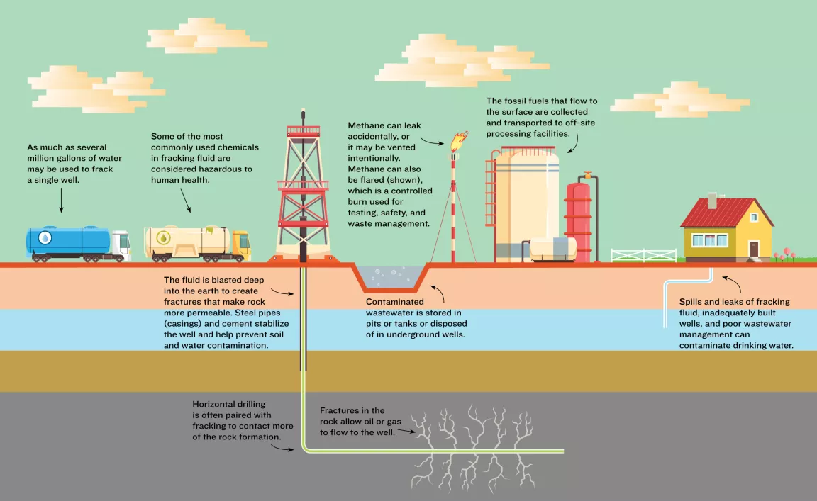
TYPICAL FRACKING OPERATION

Slide 6
Danger of VOC’s - Air Quality
Volatile Organic Compounds (VOCs)
VOCs are a group of chemicals that can vaporize into air.
Oil and gas operations, such as hydraulic fracturing, also release numerous toxic air contaminants: methane, benzene, toluene, ethylbenzene, and xylene; fine particulate matter (PM2.5); hydrogen sulfide; silica dust; and nitrogen oxides and other volatile organic compounds.
Exposure to VOC vapors can cause a variety of health effects, including:
Some VOCs are suspected or proven carcinogens.
Eye, nose, and throat irritation
Headaches and loss of coordination
Nausea
Damage to the liver, kidneys, or central nervous system.
VOCs in air pollution are also a concern because they contribute to the formation of ground-level ozone when they react with nitrogen oxides in the air.

Slide 7
General Risks of Fracking on Community Health
Air Quality
Increased Emissions
According to the cumulative impacts analysis this project expects to emit 3,997.67 tons of VOCs in 10 years.
That equals 399.7 tons or 799,400 pounds (1 ton = 2,000 pounds) per year!
For comparison, a car built after 1998 emits ~1.2 grams of VOCs per mile as found by Kennesaw.edu. That means a car driven for 12000 miles produces ~71.43 pounds of VOCs a year. (Save the Aurora Reservoir)
If one car (12,000 miles) = 71.43 pounds of VOC per year then 799,400 pounds of VOC created by the CAP is the equivalent of adding 11,191 cars to the roads per year!
11,191 cars driving 12,000 miles per year is equal to 134,292,000 miles driving per year!
The distance to Mars 140 million miles
All of this pollution is concentrated in the area around our homes!

Slide 8
Just the Facts!
A 2022 paper in Environmental Health Perspectives estimated that Pennsylvania children who lived near a fracked oil or gas well during their early years, or whose mothers lived there preconception, had approximately two to three times the odds of developing childhood acute lymphoblastic leukemia compared with children who lived farther from a well.
A 2023 journal article in Environmental Research: Health found that oil and gas air pollution in 2016 resulted in significant health impacts that year, including:
410,000 asthma exacerbations
2,200 new cases of childhood asthma
7,500 excess deaths
$77 billion in total health impacts.
Worldwide excess deaths related to particulate pollution number as many as 9 million per year

Slide 9
General Risks of Fracking on Community Health
Drinking Water
Fracking operations not only strain water resources but risk polluting them as well.
A 2016 EPA analysis found that while large data gaps and uncertainties make it difficult to fully assess the impact on drinking water, fracking operations can—and do—affect drinking water resources.
The activities that pose the biggest threats include spills and leaks of fracking fluids, the injection of fluids into inadequately built wells, and poor wastewater management practices.
Spills and leaks can occur throughout the fracking process, including during the transportation of concentrated chemical additives; the mixing and pumping of fracturing fluids; and the storage, transportation, and disposal of used fracturing fluid and wastewater.
Both human error and equipment failure can cause spills and leaks, and some spills are known to have reached surface water resources, according to the EPA.
*All facts taken from the Natural Resources Defense Council (NRDC) www.nrdc.org/stories/fracking-101#what-is
Notes:
Thinking this might be the place to insert the Erie info. Thoughts? I think that is a great idea to mention it and have it to hand out to read later.

Slide 10
General Risks of Fracking on Community Health
Water Consumption (Save the Aurora Reservoir)
Fracking fluid is 97% water
Fracking consumes a massive amount of water.
In the United States, the average can run between 1.5 million and 9.7 million gallons of water to frack a single well, according to the USGS.
Fracking operations can strain resources in areas where freshwater supplies for drinking, irrigation, and aquatic ecosystems are scarce.
Water used for fracturing is too contaminated to return to its source without extensive treatment and so typically is disposed of deep underground, where it is removed from the freshwater cycle.
The Lowry CAP will have 166 wells and use ~3.5bn gallons of water! (Save the Aurora Reservoir)
The Aurora Reservoir holds roughly 10.4 billion gallons
Civitas uses more than the industry average using 21 million gallons per well

Slide 11
Just the Facts
A 2023 report from FracTracker Alliance found that Colorado oil and gas fracking companies doubled their use of fresh water over the last 10 years (from 5 billion gallons in 2013 to more than 10 billion gallons in 2022). Water used per well went from an average of 2.7 million gallons to 10.9 million gallons during that period.
Civitas is planning to average 21 million gallons per well - well above the average
This water is permanently removed from the hydrological cycle, a dangerous trend in times of increasing and severe drought.
The water for the CAP will mostly come from Barr Lake, a privately owned reservoir, and the centerpiece of Barr Lake State Park.
Produced water will be trucked off site and will be forced into injection wells in Weld County where
they are still permitted. Injection wells of this type are known to cause earthquakes

Slide 12
Specific Dangers to this fracking project?
Aurora Reservoir
Reservoir’s are complex water systems designed to collect water. Thus, any surface level accidents, spills, or leaks risk contaminating the Aurora Reservoir.
Lowry Superfund Site
“Regulators (EPA) expressed concern in May that drilling underneath and near the Lowry Landfill Superfund Site could cause small cracks in bedrock cradling millions of gallons of toxic waste.” -Jennifer Oldham
If the Superfund Site is ruptured due to the fracking directly or other seismic activity due to the fracking, it risks introducing millions of gallons of toxic waste into our groundwater.
Denver Basin Aquifers
Is the main source of water for the Denver Metro Area. If the Superfund Site is ruptured it runs the risk of contaminating the main source of the water of this region.

Slide 13
How you can help!
ECMC Public Comments on Lowry Ranch CAP
Public comment period open until May 3rd
https://ecmc.state.co.us/permits4.html#/CAP
Please note you need a Google Account to sign in and leave a comment
Other Ways To Take Action
Talk to your neighbors about the project and its risks to our community’s water, air, and property values. Direct them to save-the-aurora-reservoir.co.
Contact your elected officials and ask them to prioritize human health and environment
Aurora city – citycouncil@auroragov.org
Arapahoe County – commissioners@arapahoegov.com
Join us on Facebook in our fight to protect our homes from fracking.
The most up-to-date information is available on our Facebook page.

Slide 14
THANK YOU BILL!
UP NEXT
Welcome Mike Foote of Sparkman & Foote LLP

Slide 15
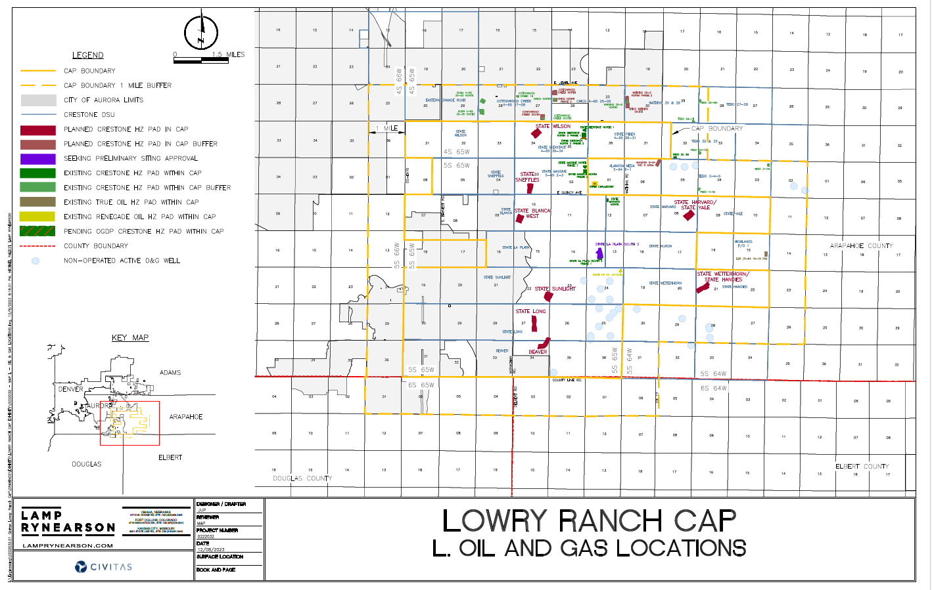

Slide 16
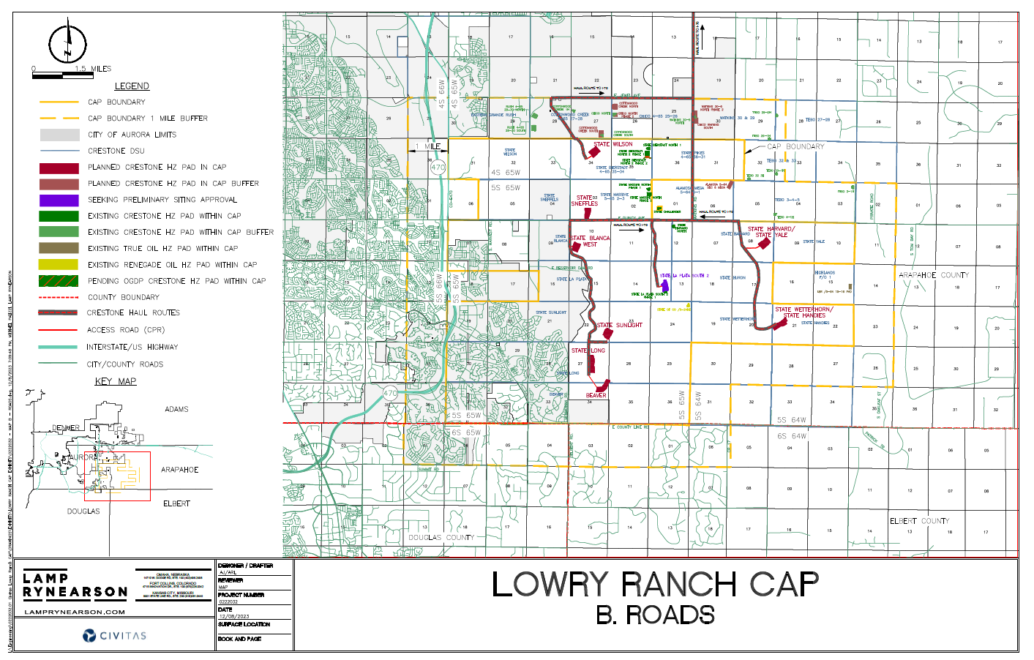

Slide 17
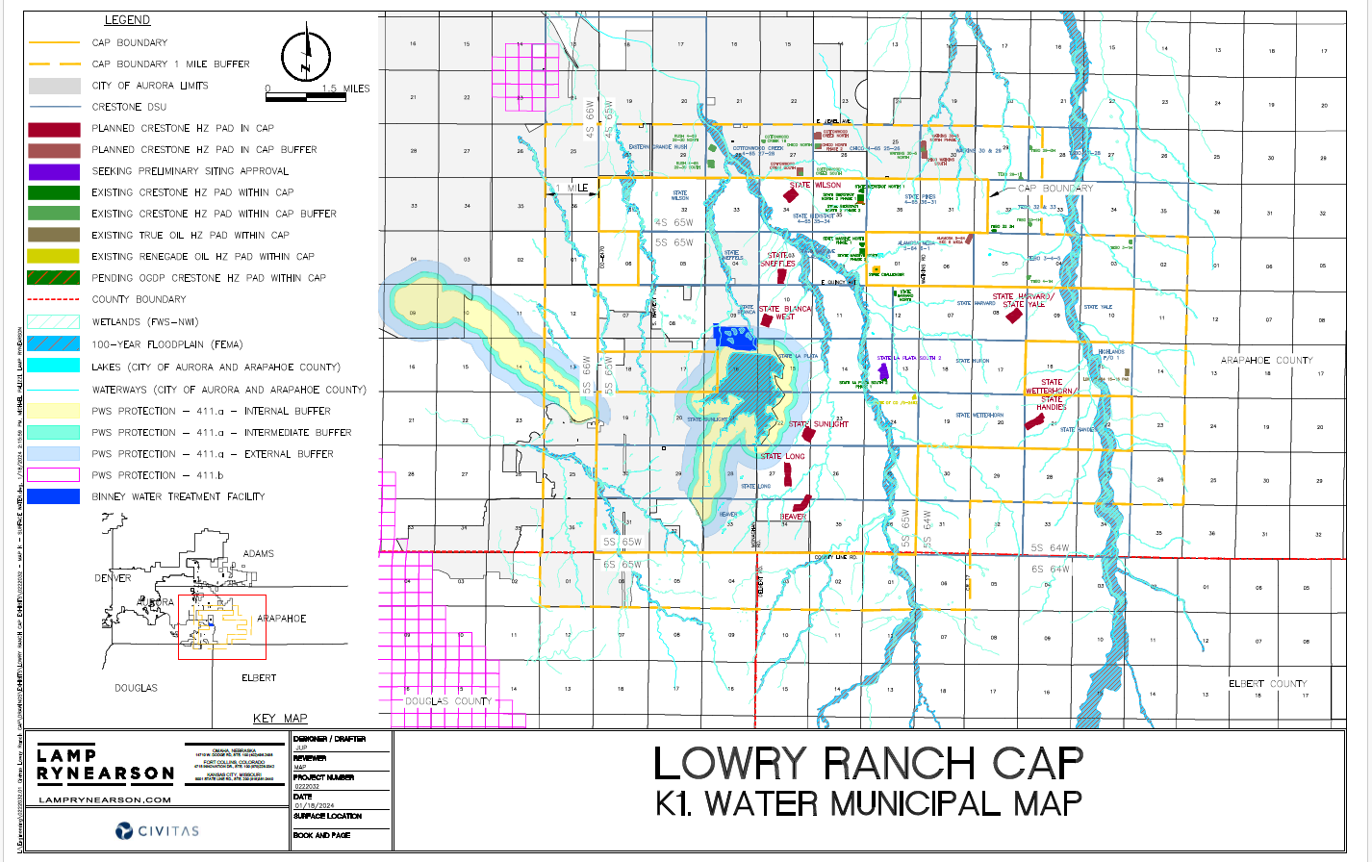

Slide 18
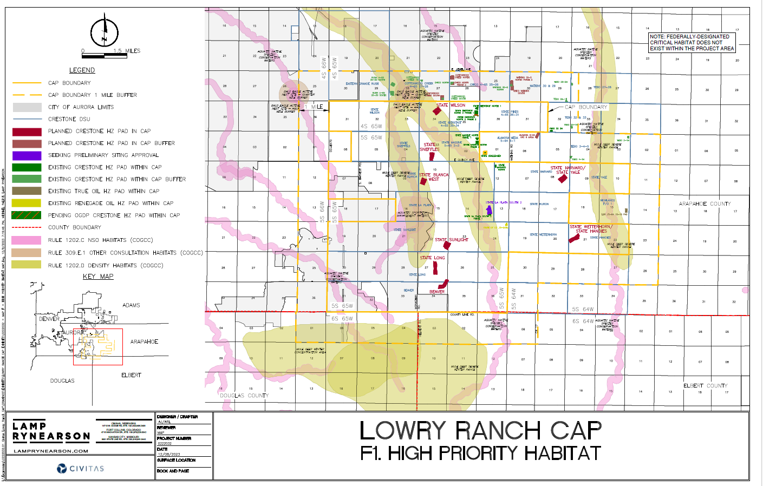

Slide 19
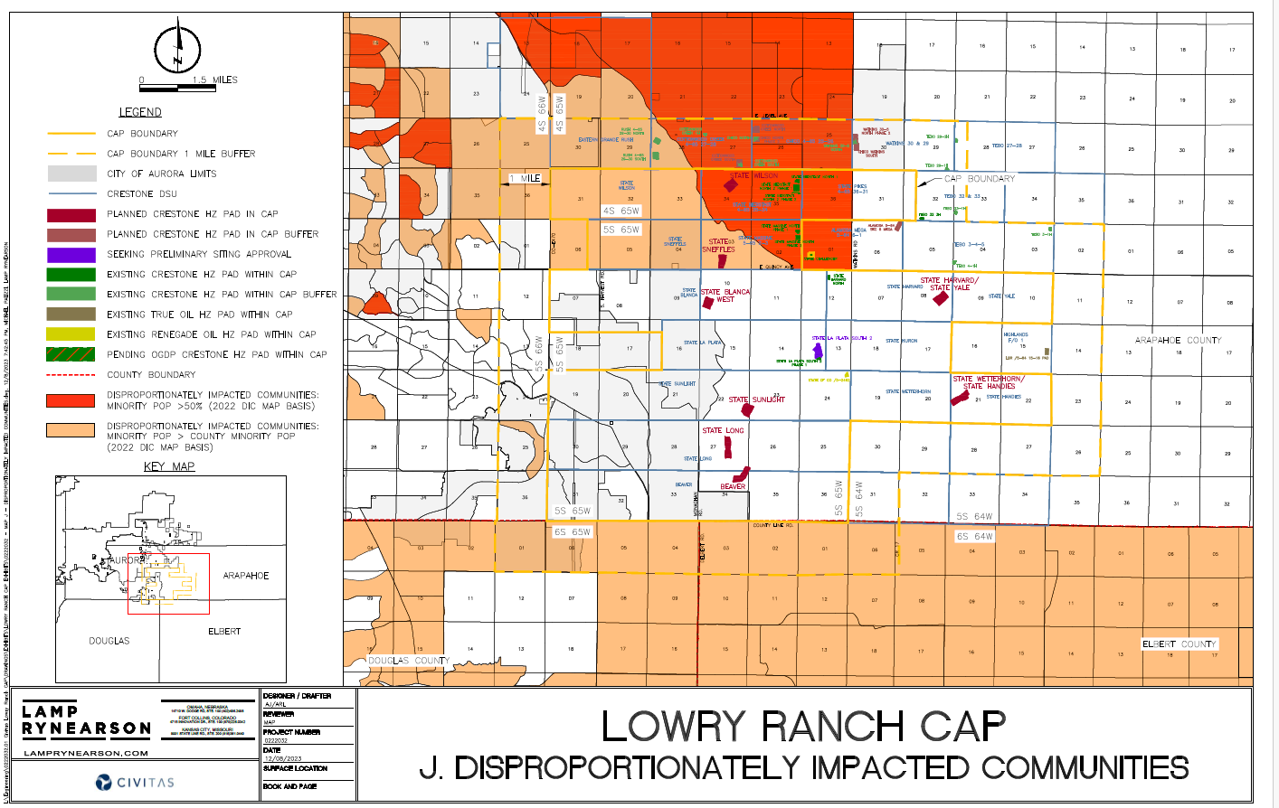

Slide 20
THANK YOU MIKE FOR ALL YOU ARE DOING!
UP NEXT Video from Shane Hall (Weld County)
This is what CAN HAPPEN
Shane has been fighting this since 2020
Needless to say it hasn’t gotten better

Slide 21
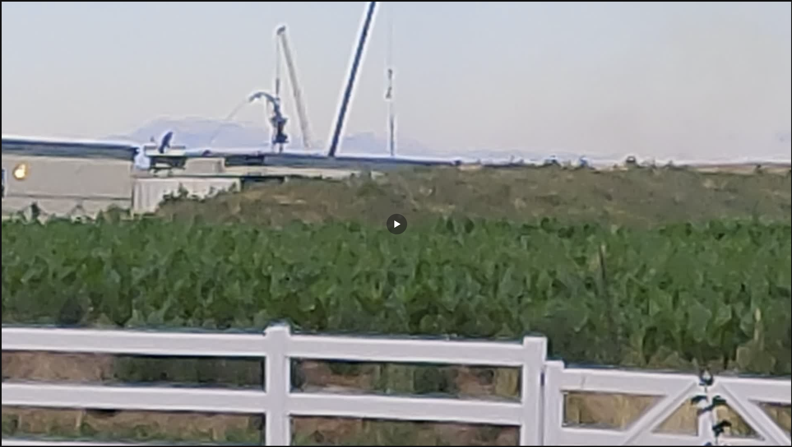
Note how close it is to his property and home

Slide 22
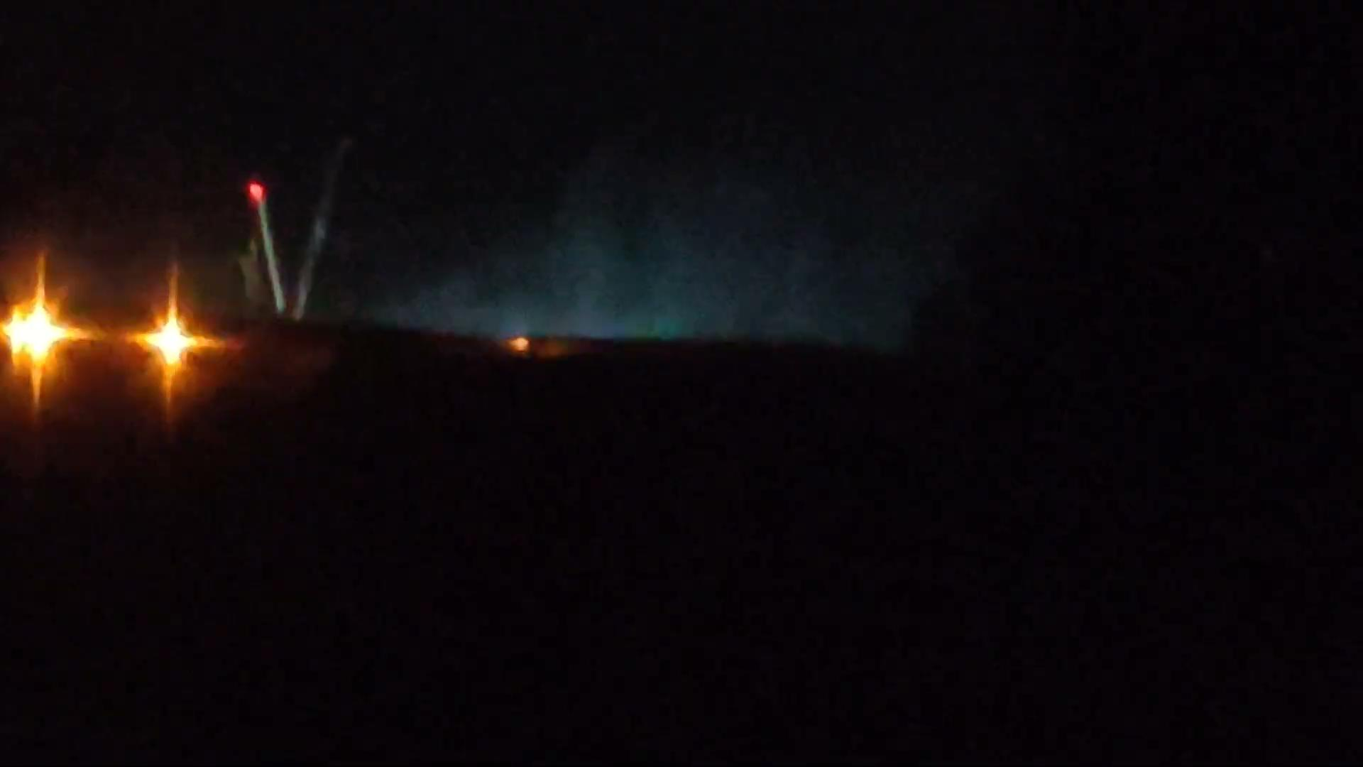

Slide 23
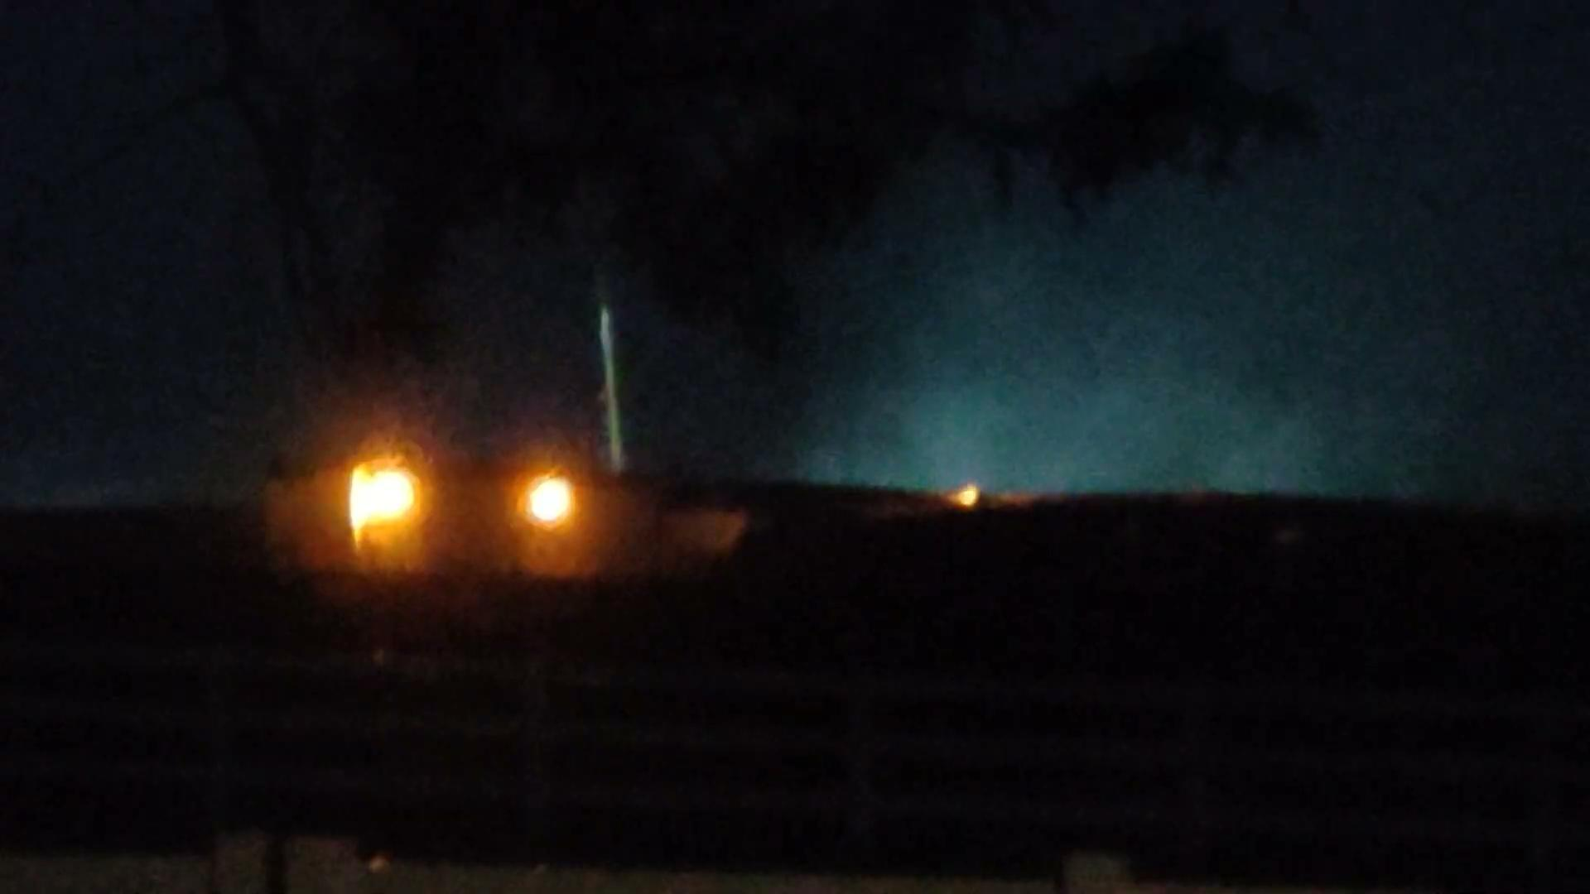

Slide 24
SHANE, THANK YOU FOR SHARING
UP NEXT
Q & A
Notes:
I would change this to Shane, thank you for sharing

Slide 25
Q & A
We extracted the top 10 questions from Facebook

Slide 26
What is this letter from Civitas all about?
They are required to inform mineral rights owners about the CAP and their plans to drill. The requirement includes a public forum advertised in 2 “local” publications. It includes the meeting that was held this week on Zoom
Q & A

Slide 27
Can we reject giving them our mineral rights?
Yes, but because of forced pooling in Colorado it is immaterial. They have the right to take your rights. There was a bill pending to address and update the Forced Pooling rules to require 90% of respondents rather than the 45% that is the current law
Q & A

Slide 28
What are the risks of sinkholes and foundation problems to our homes with the drilling?
In theory this is a very unlikely issue, but possible. The drilling is supposed to be at 7-8,000 feet below the surface. That said if they do encounter any unforeseen faults the impact could be significant to things like the reservoir dam but still is unlikely to directly affect your home.
Q & A

Slide 29
Are there any endangered species that could block them from drilling?
We are investigating this right now via some local groups as well as CPW. Hoping to find nesting pairs as well as an endangered species or two. We filed a CORA request for some recent studies. Check back & let us know if you see any nests of raptors.
Q & A

Slide 30
How do you use the map tool to find the distance of the drill pad from your house?
Go to Mark’s table right over there and he will show you
Q & A

Slide 31
I would love a “here is what we can control to try to keep this out of our backyard” primer!
This is what today is about. We wanted to share what we have done and what we can all do moving ahead. Pay special attention to the “What Can I Do” material that Marsha will present shortly..
There is a great deal we can do. Please join US
Q & A

Slide 32
Lowry Sub Area plan 1.1 requires all new developments to conserve water. How could this be approved if it’s not in compliance?
For the same reason that we continue to ignore the EPA mandates on our air. O&G gets special treatment in our state and we can tell you that the water for the project is coming from a private source so isn’t counted in the conservation plans
Q & A

Slide 33
DUPABLE
SLIDE
Q & A

Slide 34
Hopefully the City/County requires a massive Bond from oil & gas like they do for developers in the event a developer fails to complete an aspect of a project. In this case, when O&G is finished and abandons a well, how clean is the site?
This depends on the state. We have done a poor job to this point of ensuring the industry is responsible for their own messes. The phase out and CLEAN UP bill was an attempt to better address this growing problem in CO
Q & A

Slide 35
How much does this increase our fire danger?
With any big, industrial project there is more chance of fire than if nothing was done. Fracking does not seem to be a huge fire risk but the current fire plan is not sufficient in our opinion. In case of a fire the Bennett FD is the organization on the hook. We are looking to validate exactly how long response times will be. After the Marshall Fire this is a grave concern for all of us out here on the edge, especially with our high winds and dry conditions.
Q & A
Notes:
Introduce Marsha

Slide 36
What can I do to help?
Tell your story and explain to the ECMC why you will be personally affected by this, and oppose the CAP nearby a densely populated area, by following the link to send in your written comment.
Donate to STAR to assist in covering the costs to fight the project.
Purchase merchandise to support STAR and by advertising
the organization and fight against the development.
Q & A

Slide 37
What can I do to help?
Follow the STAR FB page and website to make sure that you are up to date on all action items, especially when hearings are being held and we need people to attend to fight the project.
Tell all of your social network contacts, friends, family and neighbors about this proposed CAP and encourage them to join STAR and help us fight the project being built nearby our homes.
Volunteer for STAR by helping out at events, providing any
technical or expert services and by connecting STAR to
resources.
Q & A

Slide 38
Announcements & Closing
Thank you for attending. Please, Please get involved in this righteous cause!

Slide 39
STAR BENEFIT

Slide 40
$AVE THE AURORA RE$ERVOIR
$500 pays for two hours of legal representation.
$250 pays for one hour of legal representation.
$100 helps defray the cost of all the things we do to get the word out, including one-click emails, printed educational materials, and canvassing.
We recommend donating at one of the top two levels. Your generous support is critical as we prepare for upcoming hearings and petition for Affected Party Status.
Stop by our fundraising table to make your donation today!

Slide 41
CHAT CAP
Notes:
Note that we will be having these sessions in Southshore starting later this month

Slide 42
AFFECTED PARTY STATUS
Notes:
Affected Party status means our voices are amplified within the process and may justify a local public hearing.

Slide 43
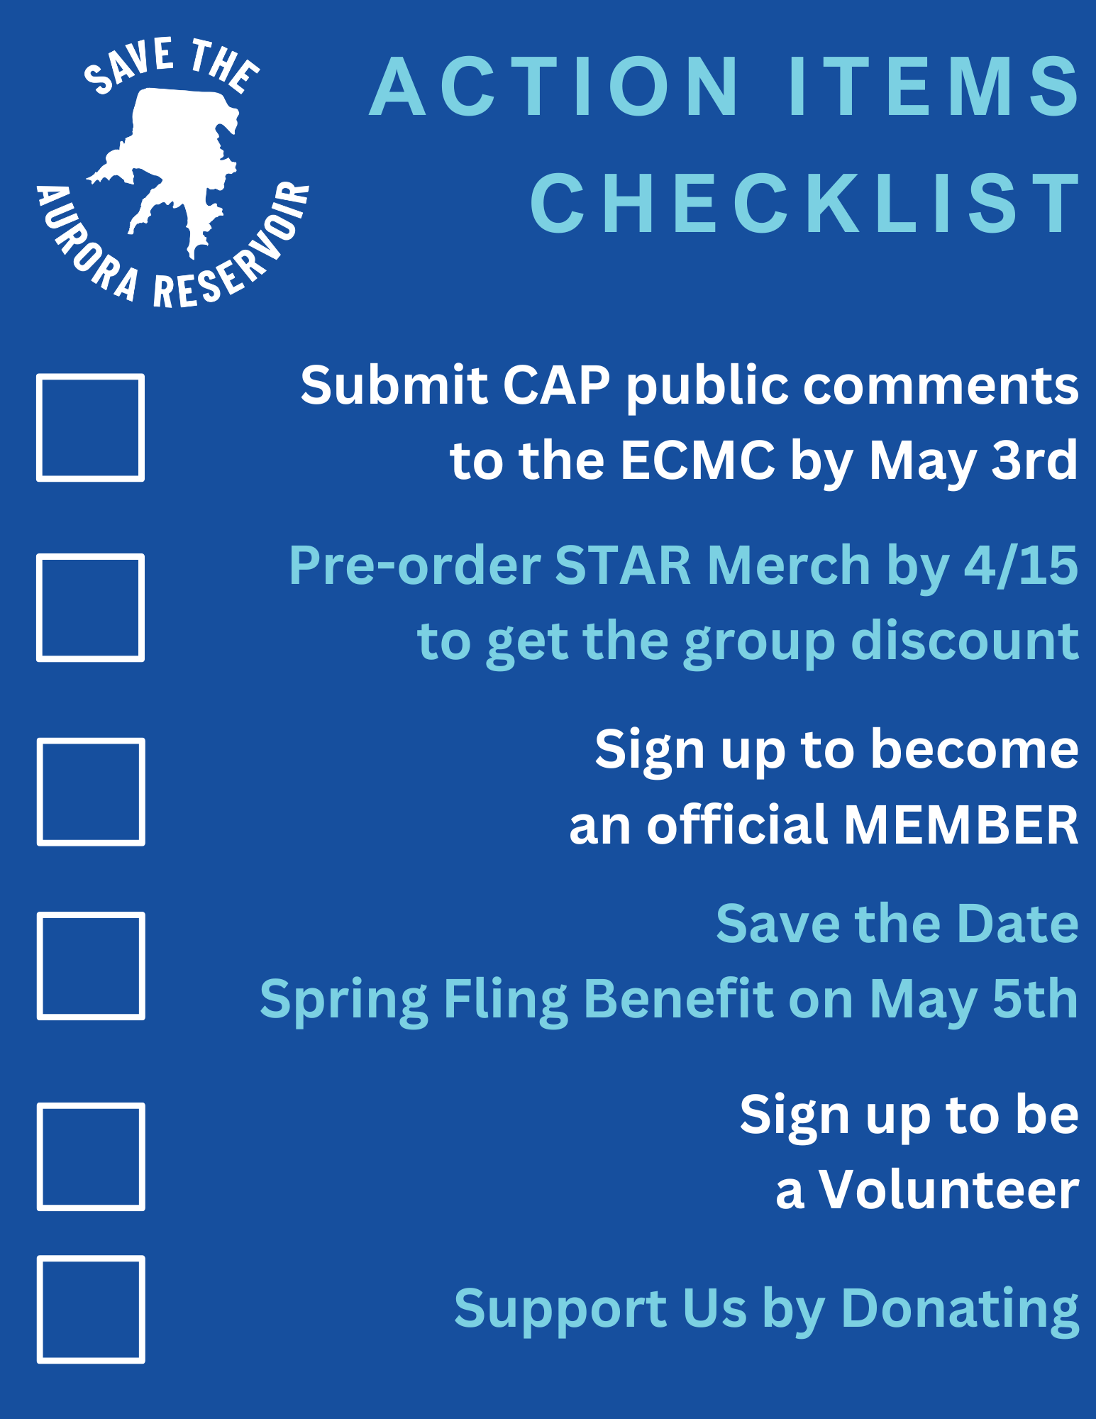
ACTION ITEMS

Slide 44
STAR BENEFIT
LIVE MUSIC
PLANT SALE
GOOD TIMES WITH THE FAMILY

Slide 45
SPRING FLING

Slide 46
Thank you for attending

